Slide 1

Session 15
Exception
Handling

Slide 2
Session Objectives
Discuss the need of exception handling
Write simple error handling routines
Explain exception matching
Explain the function terminate()
Explain the function unexpected()

Slide 3


Introduction
An exception can be called as an error or an unexpected event
C++ provides a built in mechanism for handling errors
known as exception handling
Exceptions can occur due to
Synchronous events
Asynchronous events

Slide 4
Need for Exception Handling
Exceptions might cause unpredicted
program termination
Hardware Problems
C++ statements can be used to check errors
but then they become redundant through the
program, consume space and time

Slide 5
Steps to Handle Exceptions
Monitor the code, which is likely to
generate exceptions
On detection of error, pass the information
to take corrective measures
Take the remedial actions

Slide 6
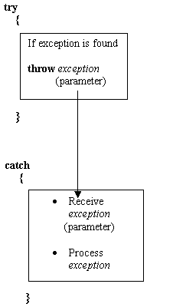
Keywords used
try
throw
catch

Slide 7
Basics
Statements throwing exceptions
must be executed in the try block
Functions called from the the try
block can throw exceptions
A thrown exception must have
at least one corresponding catch
A single throw can have multiple
catch blocks

Slide 8
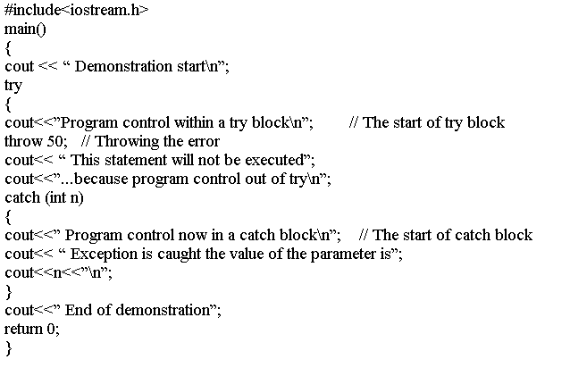
Example (1)

Slide 9
Example (2)
Demonstration start
Program control within a try block
Program control now in catch block
Exception is caught the value of the parameter is 50
End of demonstration

Slide 10
A throw outside try
main ()
{
try
{
outfunc(0);
outfunc(1);
}
catch
{
:
}
}
void outfunc(int i)
{
if (i= =0)
{
:
throw i;
}
}

Slide 11
Localized try and catch
void test (int k)
{
try
{
;
}
catch
{
:
}
}
main()
{
:
test ( i );
:
}

Slide 12
Multiple catch blocks
void handler(int value)
{if(value)
{throw value;}
else
{throw ”throwing string”;}
}
catch(char *strin)
{cout<<“string caught”;}
catch(int d)
{cout<<“Integer caught”;}
}
main()
{
:
handler ( 1 );
handler ( 0 );
:
}

Slide 13
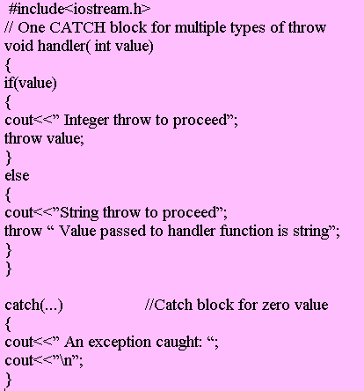
One catch and all Exceptions (1)
Use catch(…) form
Default catch block

Slide 14
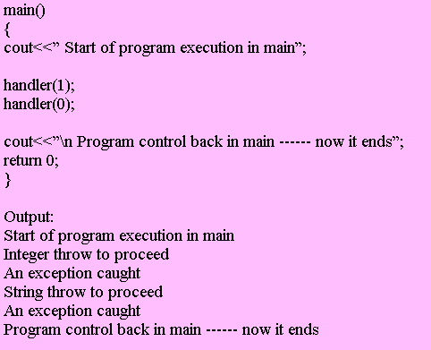
One catch and all Exceptions (2)

Slide 15
Restricting Exceptions (1)
The type of exceptions that a function can raise
can be predefined in the function definition
ret-type function-name(argument list) throw(type-list)
The type of exceptions that can be raised

Slide 16
Restricting Exceptions (2)
The function cannot
throw any exception
If type-list is empty
If a function throws an exception
other than mentioned in the type-list
unexpected ( )
abort ( )

Slide 17
Special functions (1)
terminate ( )
unexpected ( )
abort ( )
abort () is an emergency stop, the program terminates immediately

Slide 18
terminate ( )
If a function raises an exception which does not
have a corresponding catch block
unexpected ( )
abort ( )
Immediate program termination

Slide 19
Unexpected ( )
If a function throws a parameter which does not
match the parameter in the corresponding catch block
unexpected ( )
abort ( )
Immediate program termination

